Slide 1

WELL COME

Slide 2
PREFACE
.HABIBUR RAHMAN
ASSISTANT TEACHER CLASS:NINE
BHUAPUR TANGAIL PAPER
GOBINDASHI HIGH SHCOOL SUB:ENLISH FIRST
UNIT: SIX LESSON :ONE

Slide 3

NATIONAL FLAG OF NEPAL

Slide 4
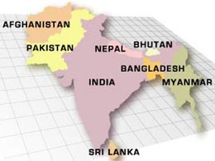
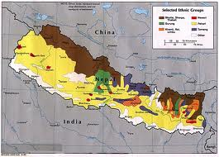

Slide 5
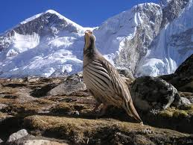
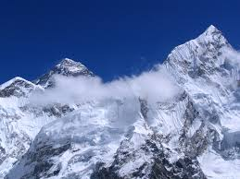
CAN YOU TELL THE NAME OF THIS MOUNTAIN?

Slide 6
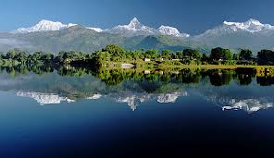
NEPAL THE LAND OF EVEREST

Slide 7
OBJECTIVES
WILL BE ABLE TO TELL ASK AND ANSWER
WILL CONVERSE ON TOURISM
WILL BE ABLE TO WRITE THE NAME OF RELIGIOUS FESTIVALS AND EHINIC GROUP OF NEPAL

Slide 8
TEXT READING
READ THE FOLLOWING PASSAGE ON NEPAL.

Slide 9
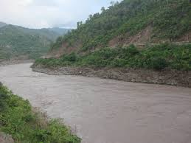
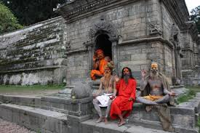


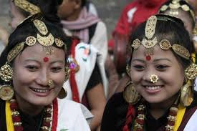
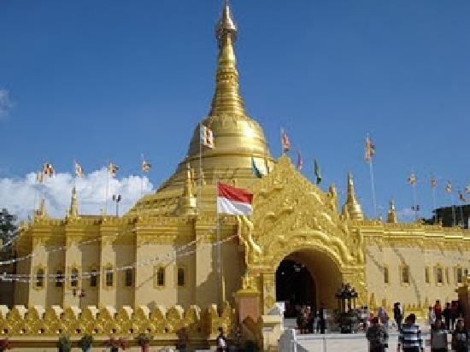
VOCABULARY
VELLY
WORSHIPER
ETHINIC GROUP
TEMPLE

Slide 10
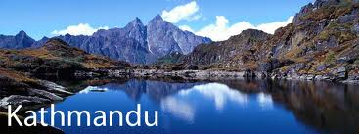
CAPITAL OF NEPAL

Slide 11
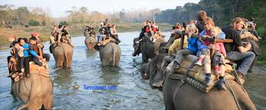
PERADISE OF TOURIST

Slide 12
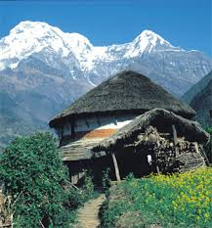
THE LAND OF SENIC BEUATY

Slide 13
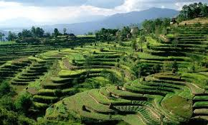
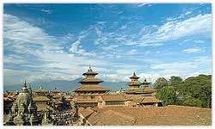

Slide 14
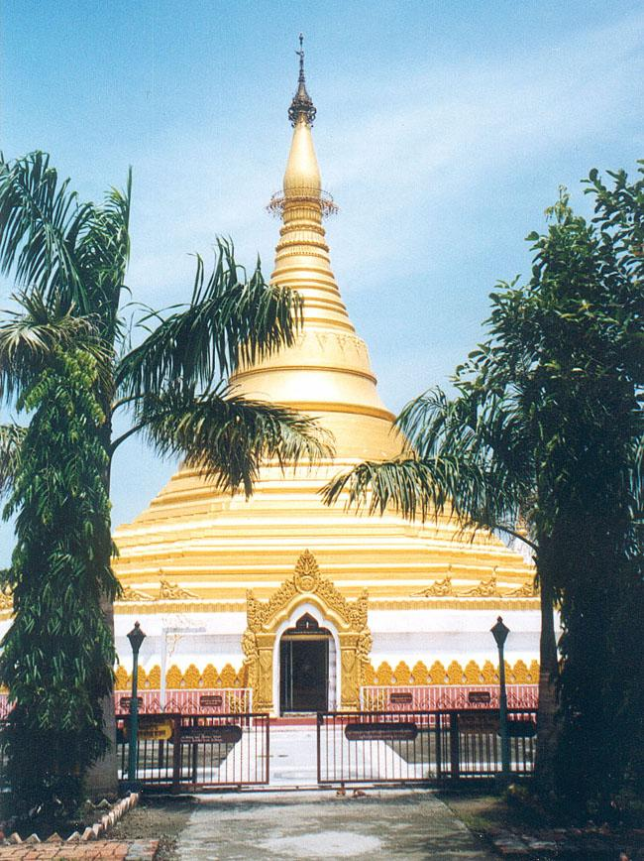
VELLY OF PATAN
TEMPLE OF LUMBINI BUDDAS BIRTH PLACE

Slide 15
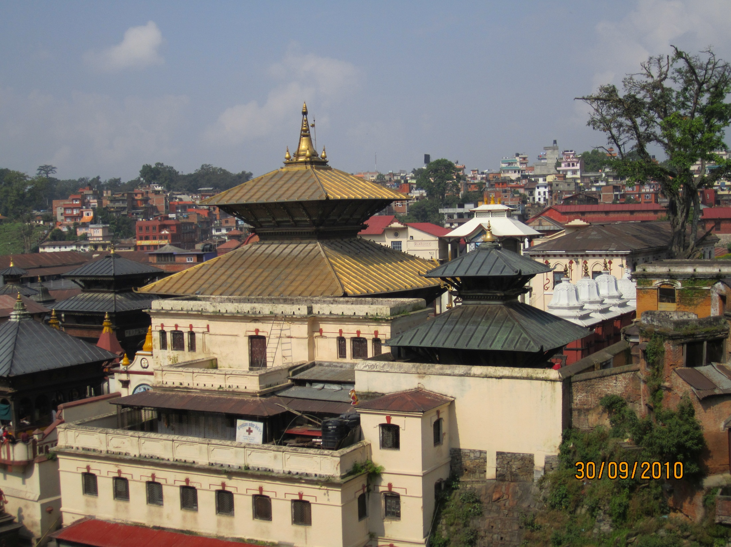
THE TEMPLE OF PASHUPATINATH FOR SHIVA WORSHIPERS OF HINDUS

Slide 16
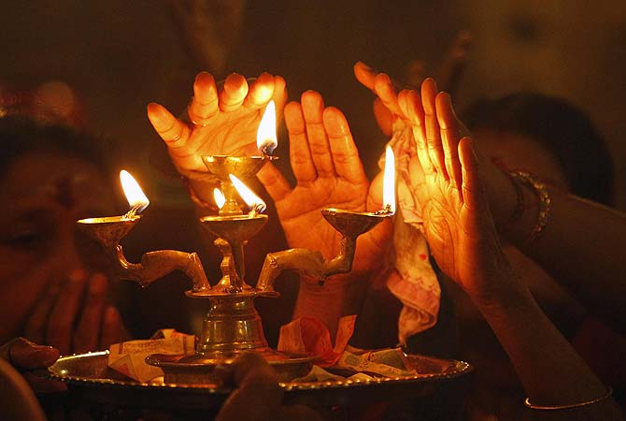
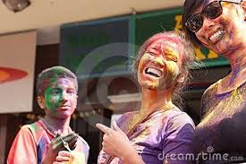
RELIGIOUS FESTIVALS
MAHA SIVARATRI
HOLI

Slide 17
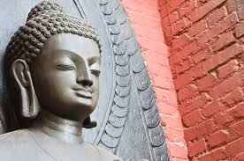
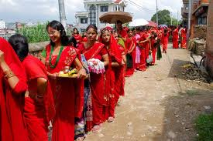
DASAIN

Slide 18
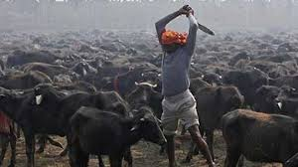


Slide 19
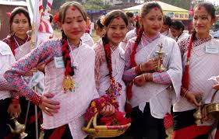
ETHINIC GROUP 103 KINDS
THARU

Slide 20
TAMANG

Slide 21
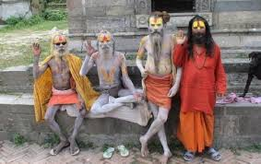
MAGAR

Slide 22
GROUP WORK
WRITE DOWN THE THREE NAME OF ETHINIC GROUPS LIVE IN NEPAL
GIVE AT LEAST THREE REASONS WHY YOU MIGHT BE INRESTED TO VISIT NEPAL.

Slide 23
EVALUTION
HOW IS THE SENIC BEAUTY OF NEPAL?
MAKE A LIST OF THE FESTIVALS THAT ARE CELEBATED IN NEPAL.

Slide 24
HOME WORK
WRITE A LETTER TO YOUR FRIEND HIGHLIGHTING THE MAIN ATTRACTION OF NEPAL.

Slide 25

THANKS

